Slide 1
Digital Strategy 2024 – 2027
Easy Read Version
There may be words in this easy read that you haven’t heard before. These words are written in thick black letters.
There is a list to explain these words at the end of this document.
Fife Health and Social Care Partnership want the people of Fife to live healthy, active and independent lives.

Slide 2
We plan to use more digital devices that can support people to lead more healthy and independent lives at home and in the community.
Our new digital strategy is a plan that explains how we will do this.
Our new digital strategy starts in 2024 and ends in 2027.
We will show people how digital devices can help them to be more independent at home.

Slide 3
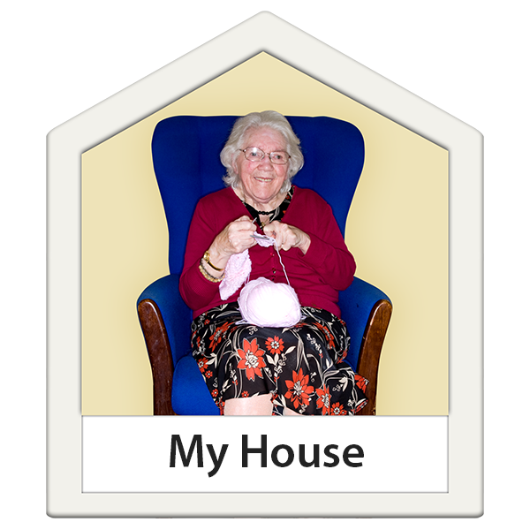
We will support the people of Fife to be digitally connected in their communities and have access to health and social care information and services.
We will find new ways of using digital devices to ensure that people who need care and support can remain safely at home for as long as possible.
Our staff will explain the digital devices in a way that people understand, treat them with respect, listen to them and answer their questions.
We will make sure that our staff can answer questions and know who to contact if a supported person or their carer has questions or concerns that they can’t answer.

Slide 4
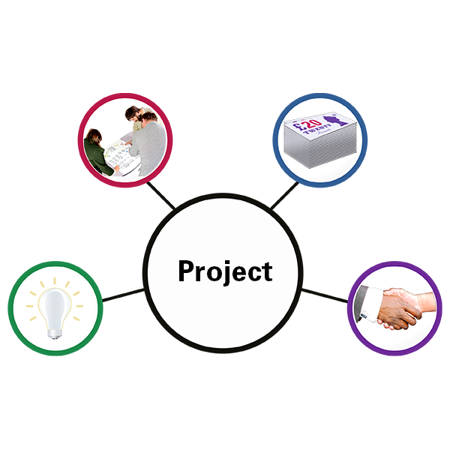
Some of the devices will provide us with useful information that we can use to make decisions with people.
There are lots of new digital devices available. We will find out about these devices and how we can use them to improve the services that we deliver and to increase people’s independence.
When we start new projects, we will discuss digital devices and how these might help us to deliver a better service.
This strategy will help to improve health and social care services in Fife for people who use them and for staff who support them.

Slide 5
If you would like more information, please contact fife.hscptransformationalchangeteam@nhs.scot.
What these words mean
Digital Devices | A name to describe equipment such as computers, smart meters, smart TVs, i-pads, tablets, Alexa, google dot, smart phones and other devices.
Fife Health and Social Care Partnership | The name of the organisation that provides health and social care services to the people of Fife. This includes GPs, nurses, social workers, home carers and other staff.
Strategy | A strategy is the name given to a document or plan which explains what an organisation wants to do over the next few years.
Published April 2024 by Fife Health and Social Care Partnership using a licensed version of Photosymbols.

